Slide 1
Fundamentals
SOFTWARE QUALITY ASSURANCE (SQA)

Slide 2
Testing Principles

Slide 3

Testing always uncovers defects but never tell us how many more are still undiscovered(absence of defects).
Testing Shows Presence of Defects
Exhaustive Testing is Impossible
It is impossible to test with every possible input combinations.
Testing should start as early as possible. So that defects in the requirements or design phase are captured in early stages(defects prevention).
Early Testing
Saves Time & Money
It is possible that software which is 99% bug-free is still unusable; requirement or expectation may not be meet.
Absence of Errors Fallacy
Defects Clustering
Defects present in the form of clusters; approximately 80% of the problems are found in 20% of the modules.
Testing a banking application is different than testing any
e-commerce or gaming application.
If the same set of repetitive tests are executed, then it will be useless for discovering of new defects.
Testing is Context Dependent
Pesticide Paradox

Slide 4
Test Design Technique - STATIC
Test Design Techniques
Static
Dynamic
Structured Based
Experienced Based
Specification Based
Reviews
Static Analysis
Informal
Inspection
Technical
Walkthroughs
Coed Metric
Control Flow
Data Flow
Statement
Branch/Decision
Condition
Error Guessing
Exploratory
BVA
ECP
State Transition
Use Case
Decision Table

Slide 5
Static Introduction

Slide 6
Static Testing

Slide 7
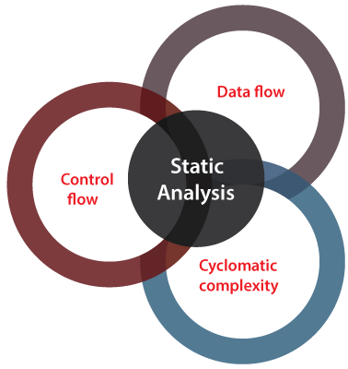
Static Analysis
Static Analysis
Standard Compliance
Code Metrics
Data Flow Analysis

Slide 8
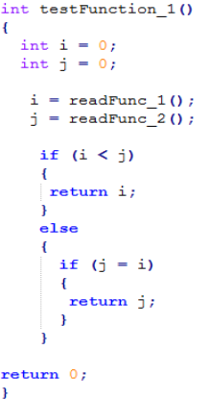
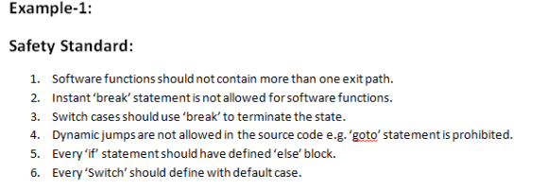
Standard Compliance
Static Analysis

Slide 9
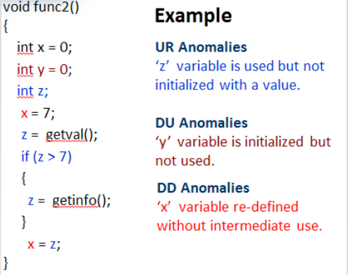
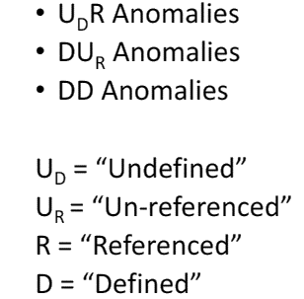
Data Flow Analysis
Static Analysis

Slide 10
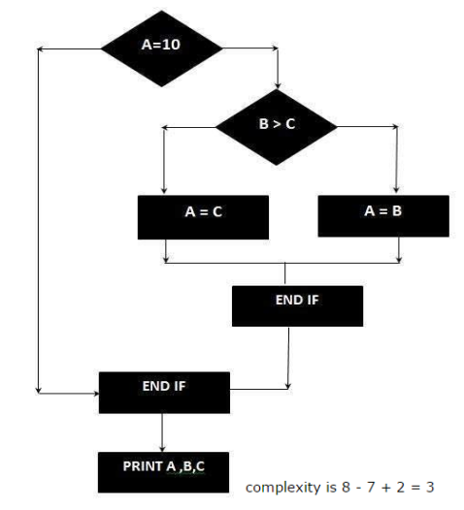
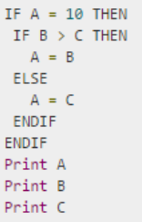
Code Metric – Cyclomatic Complexity
Static Analysis
Cyclomatic Code Complexity CC = E – N + 2P
E = Number of Edges N = Number of Nodes in Graph (Shapes) P = Exit Paths

Slide 11
Cyclomatic Complexity
1
INPUT A
INPUT B
INPUT C
WHILE (A < 20)
PRINT A + B
IF (A == C)
PRINT A
ELSE
PRINT C
END OF DO
IF(C <= 100)
PRINT A+B
ELSE
PRINT A-B
END
2
3
8
9
10
4
5
6
11
7

Slide 12
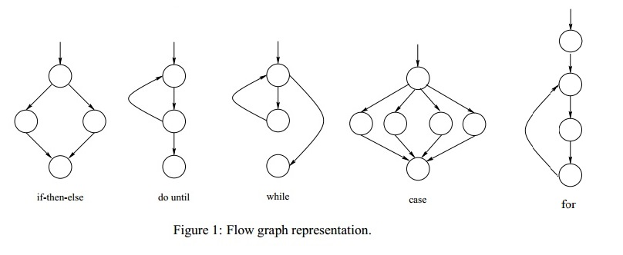
Code Metric – Cyclomatic Complexity
Static Analysis

Slide 13
White Box Techniques

Slide 14
White Box Types
White Box Testing
White Box Techniques
Statement Coverage
Decision Coverage
Condition Coverage
Minimum no of test cases required to cover all statements
Minimum no of test cases required to cover all conditions
Minimum no of test cases required to cover all decision or branches

Slide 15
White Box Types
White Box Testing
Statement Coverage
Statement Coverage is a white box testing technique in which all the executable statements in the source code are executed at least once.
It is used for calculation of the number of statements in source code which have been executed.
The main purpose of Statement Coverage is to cover all the possible paths, lines and statements in source code.
Statement coverage is used to derive scenario based upon the structure of the code under test.

Slide 16
White Box Types
White Box Testing
Find Statement Coverage
Print (int a, int b){
int result = a + b ;
If (result > 0)
Print (“Positive” , result)
Else
Print (“Negative", result)
}

Slide 17
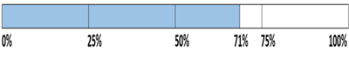
White Box Types
White Box Testing
Scenario #1
If A= 3 , B = 9
Print (int a, int b){
int result = a + b ;
If (result > 0)
Print (“Positive” , result)
Else
Print (“Negative", result)
}
The statements marked in yellow color are those which are executed as per the scenario
Number of executed statements = 5, Total number of statements = 7
Statement Coverage: 5/7 = 71%

Slide 18
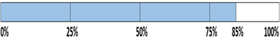
White Box Types
White Box Testing
Scenario #2
If A= -3 , B = -9
Print (int a, int b){
int result = a + b ;
If (result > 0)
Print (“Positive” , result)
Else
Print (“Negative", result)
}
The statements marked in yellow color are those which are executed as per the scenario.
Number of executed statements = 6 , Total number of statements = 7
Statement Coverage: 6/7 = 85%

Slide 19
White Box Types
White Box Testing
Find Statement Coverage
Add (int a, int b){
If (b > a){
b = b – a
Print b
}
If (a > b) {
b = a – b
Print b
}
Else Print ‘0’
}

Slide 20
White Box Testing - Activity
White Box Techniques
Decision Coverage
Decision Coverage is a white box testing technique which aims to ensure that each one of the possible branch from each decision point is executed at least once and thereby ensuring that all reachable code is executed.
In Decision Coverage (also know as Branch Coverage) you have to test all possible branches.
Decision coverage covers all possible outcomes of each and every condition of the code by using control flow graph or chart.
The percent of decision coverage can be found by dividing the number of exercised outcome with the total number of outcomes and multiplied by 100.

Slide 21
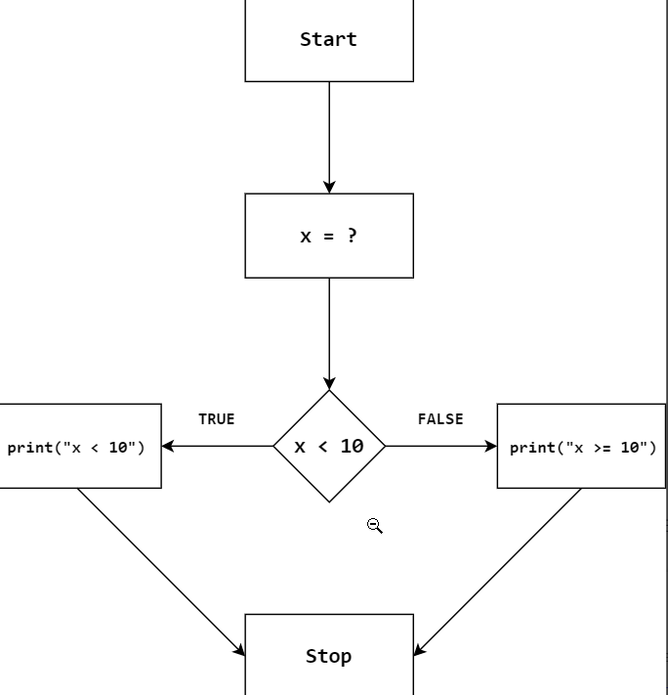
White Box Testing - Activity
White Box Techniques
Example :Consider the following pseudocode and Control Flow Graph:
Example (int x)
{
If (x < 10 )
Print (“ X < 10 ”)
Else
Print (“ X > = 10 ”)
}

Slide 22
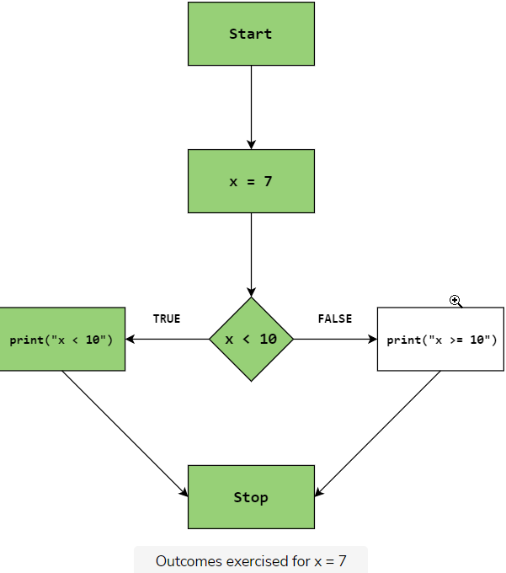
White Box Testing - Activity
White Box Techniques
Scenario #1
If X = 7
For the case x = 7, the true branch of the decision point is taken. The regions of the graph that are traversed are highlighted in green color.
The decision coverage is:
Coverage = 1\2* 100 = 50\%

Slide 23
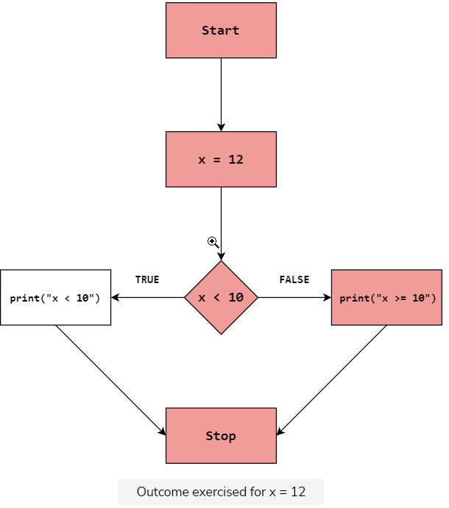
White Box Testing - Activity
White Box Techniques
Scenario #2
If X = 12
For the case x = 12, the false branch of the decision point is taken. The regions of the graph that are traversed are highlighted in red color.
The decision coverage is:
Coverage = 1\2 * 100 = 50\%

Slide 24
White Box Testing - Activity
White Box Techniques
Now that we have attained a total decision coverage of 100% (50 + 50), let’s summarize the result in the form of a table.
Test Case | Value of X | Expected Output | Observed Output | Decision Coverage | Result
1 | 7 | "x < 10" | "x < 10" | 50% | Pass
2 | 12 | "x >= 10" | "x >= 10" | 50% | Pass

Slide 25
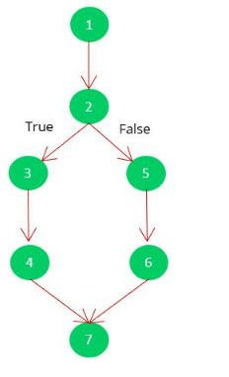
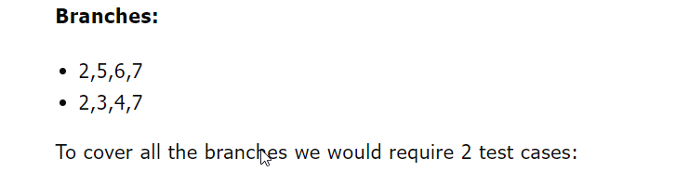
White Box Testing - Activity
White Box Techniques
Decision Coverage are also called the branch coverage
The main aim of branch coverage is to cover all the branches (two separate paths) at least once (true and false)
Branch Coverage is a structurally based technique that checks both conditional and unconditional branches.
Branch Coverage = (number of executed branches / total number of branches) * 100
Example pseudocode
1. READ A
2. IF A == 10
3. THEN
4. PRINT I am True
5. Else
6. PRINT I am False
7. ENDIF

Slide 26
White Box Testing - Activity
White Box Techniques
Condition Coverage
Condition coverage testing is a type of white-box testing that tests all the conditional expressions in a program for all possible outcomes of the conditions.
It is used to cover all Conditions.
Condition coverage is also known as Predicate Coverage in which each one of the Boolean expression have been evaluated to both TRUE or FALSE

Slide 27
White Box Testing - Activity
White Box Techniques
Example pseudocode
Read a ,b ,c ,d ;
If (a == 0 || b == 0)
{
Print 1;
}
else
{
If (c == 0 && d == 0)
{
Print 2;
}
}

Slide 28
White Box Testing - Activity
White Box Techniques
Example 1
READ num1,
READ num2,
if((num1>0 || num2<10)){
count<<"valid input";
}else{
count<<"invalid input";
}
Test case number | num1>0 | num2<10 | Final output
1 | True | Not required | True
2 | False | True | True
3 | False | False | False

Slide 29
White Box Testing - Activity
White Box Techniques
Example 2
READ num1,
READ num2,
if((num1>0 || num2<10) && (num1+num2<15)){
count<<"valid input";
}else{
count<<"invalid input";
}
Test case number | num1>0 | num2<10 | num1+num2<15 | Final output
1 | True | don't care | True | True
2 | True | don't care | False | False
3 | False | True | True | True
4 | False | True | False | False
5 | False | False | Not required | False

Slide 30
Database Testing

Slide 31
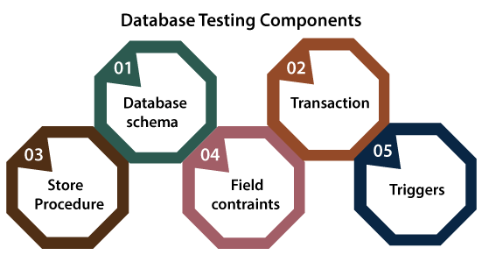
What is Database Testing?
It is the process of testing database functions, triggers, and SQL queries. Thereby validating database tables, data models, and database schema as per information provided at the User Interface.
It also checks data integrity and consistency.
It may involve creating complex queries to load/stress test the Database and check its responsiveness.

Slide 32
UI Testing vs Database Testing
User Interface Testing | Database Testing
It is generally regarded as front-end or GUI testing. | It is generally regarded as back-end or data testing.
It mainly deals with testing of functionality and responses of web application and web pages. | It mainly deals with testing of data storage and retrieval from front end to database and vice-versa.
This type pf testing includes validating the: Text boxes Select dropdowns, calendars and buttons. Navigation from one page to another as well as display of images. | This type of testing involves the validating the: Schema Database tables, keys, indexes, triggers, stored procedures. Database server validations and validating data duplication.

Slide 33
Why Database Testing is Important?
Database Testing is Important in software testing because it ensures data values and information received and stored into database are valid or not.
Database testing helps to save data loss, saves aborted transaction data and no unauthorized access to the information.
Database is important for any software application hence testers must have good knowledge of SQL for database testing.

Slide 34
Database Testing Types

Slide 35
Based on the function and structure of a database, DB testing can be categorized into three categories
Database Testing Types
Structural Testing
Functional Testing
Non-Functional Testing
It deals with table and column testing, schema testing, stored procedures and views testing, checking triggers, etc.
It involves checking functionality of database from user point of view.
It involves load-testing, risk testing in database, stress testing, minimum system requirements, and deals with the performance of the database.

Slide 36
Structural Database Testing
Structural database checking entails the verification of all items within the data repository that are exclusively used for data collection and cannot be directly accessed by end users. In these types of tests, database server validation is also a critical factor to remember. The testers must master SQL in order to complete this process successfully.
Schema / Mapping Testing - It entails using database object mapping to validate the objects of a front-end application.
Stored Procedures Testing - This test ensures that manual execution of stored procedure and view generate desired results.

Slide 37
Functional Database Testing
A type of database testing that is used to validate the functional requirements of a database from the end-user’s perspective. The main goal of functional database testing is to test whether the transactions and operations performed by the end-users which are related to the database works as expected or not.
Following are the basic conditions that need to be observed for database validations.
Whether the field is mandatory while allowing NULL values on that field?
Whether the length of each field is of sufficient size?
Whether all similar fields have the same names across tables?
Whether there are any computed fields present in the Database?

Slide 38
Non-Functional Database Testing
Comprises of load testing, stress testing, ensuring that minimum system criteria are met in order to satisfy business specifications, risk identification, and database performance optimization. Tests can include are
Security testing - It is a type of Testing that identifies the system vulnerabilities, threats, risks and prevents malicious attacks from intruders.
Stress testing - With Stress Testing evaluates the robustness and error-handling capabilities under harsh load conditions.
Volume testing - System performance is analyzed by increasing the volume of data in the database.
Load Testing - This test determines how database behaves while being accessed by multiple users simultaneously

Slide 39
ACID Properties Validation

Slide 40
Atomicity
Transactions are all or nothing
Durability
Written data will not be lost
Isolation
Transaction do not affect each other
Consistency
Only valid data is saved
Notes:
Atomicity - a transaction to transfer funds from one account to another involves making a withdrawal operation from the first account and a deposit operation on the second. If the deposit operation failed, you don’t want the withdrawal operation to happen either.
Consistency - a database tracking a checking account may only allow unique check numbers to exist for each transaction
Isolation - a teller looking up a balance must be isolated from a concurrent transaction involving a withdrawal from the same account. Only when the withdrawal transaction commits successfully and the teller looks at the balance again will the new balance be reported.
Durability - A system crash or any other failure must not be allowed to lose the results of a transaction or the contents of the database. Durability is often achieved through separate transaction logs that can "re-create" all transactions from some picked point in time (like a backup).

Slide 41
ACID
Suppose Ali has an account with an amount of RS 15000. There is Baber’s account having RS 5000. We are transferring the amount of RS 10000 from Ali’s account to Baber’s account. Now we see how we can ensure data reliability using ACID properties in DBMS.
So let us have some insight over the ACID properties in DBMS.

Slide 42
Atomicity
ACID
It simply says, “All or Nothing”. There is no intermediate.
If you are doing any database transaction (set of the read/write operations), all the operations should be executed otherwise none.
All the operation in the transaction is considered to be one unit or atomic task.
If the system fails or any read/write conflicts occur during the transaction, the system needs to revert back to its previous state.
Example:
Here, the set of operations are
Deduct the amount of RS 10,000 from Ali’s account.
Add amount RS10,000 to Baber’s account.
All operations in this set should be done.
If the system fails to add the amount in Baber’s account after deducting from Ali’s account, revert the operation on Ali’s account.

Slide 43
Consistency
ACID
Every attribute in the database has some rules to ensure the stability of the database. The constraint puts on the data value should be constant before and after the execution of the transaction.
If the system fails because of the invalid data while doing an operation, revert back the system to its previous state.
Example:
The total amount in Ali’s and Baber’s account should be the same before and after the transaction. The sum of the money in Ali and Baber’s account before and after the transaction is RS 20,000. So, this transaction preserves consistency ACID properties in DBMS.

Slide 44
Isolation
ACID
If you are performing multiple transactions on the single database, operation from any transaction should not interfere with operation in other transactions. The execution of all transactions should be isolated from other transactions.
Example:
If there is any other transaction (between Haris and Ali) going, it should not make any effect on the transaction between Ali and Baber. Both the transactions should be isolated.

Slide 45
Durability
ACID
All the previous three properties should be satisfied while the transaction in progress. But durability issues can happen even after the completion of the transaction.
So, this is the ACID Property After Completion of Transaction
The changes made during the transaction should exist after completion of the transaction.
Sometimes it may happen as all the operation in the transaction completed but the system fails immediately. In that case, changes made while transactions should persist. The system should return to its previous stable state.
Example:
It may happen. A system gets crashed after completion of all the operations. If the system restarts it should preserve the stable state. An amount in Ali and Baber’s account should be the same before and after the system gets a restart.

Slide 46
Database Keys

Slide 47
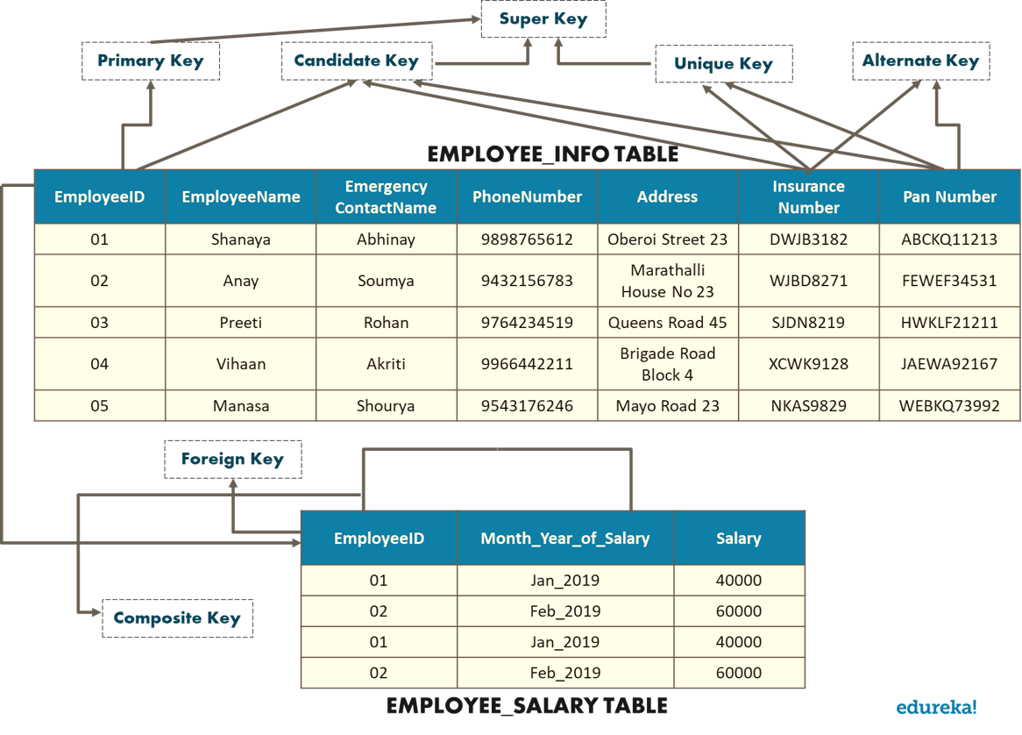
Database Keys

Slide 48
SQL

Slide 49
Database Joins
JOIN is an SQL clause used to query and access data from multiple tables, based on logical relationships between those tables
Different types of JOINS in SQL Server
INNER JOIN creates a result table by combining rows that have matching values in two or more tables.
LEFT OUTER JOIN creates a result table and includes into it all the records from the left table and only matching rows from the left table.
RIGHT OUTER JOIN creates a result table and includes into it all the records from the right table and only matching rows from the left table.
SELF JOIN joins the table to itself and allows comparing rows within the same table.
CROSS JOIN creates a result table containing paired combination of each row of the first table with each row of the second table.

Slide 50
Database Joins
SQL JOINS
LINK

Slide 51
Class Activity (JOINS)
Use this link for practicing JOINS
https://www.w3schools.com/sql/sql_join.asp

Slide 52
SQL Constraints
Not Null
Indicates that a column cannot store NULL value
Unique
Ensures that each row for a column must have a unique value
Primary
Foreign
Check
Default
A NOT NULL and UNIQUE ensures that a column(s) have a unique identity which represents a record uniquely
Ensure the referential integrity of the data in one table to match values in another table
Ensures that the value in a column meets a specific condition
Specifies a default value for a column

Slide 53
SQL Constraints
Use this link for practicing Function Queries
http://www-db.deis.unibo.it/courses/TW/DOCS/w3schools/sql/sql_constraints.asp.html#gsc.tab=0

Slide 54
SQL Functions
SQL has many built-in functions for performing calculations on data.
Useful aggregate functions:
AVG() - Returns the average value
COUNT() - Returns the number of rows
FIRST() - Returns the first value
LAST() - Returns the last value
MAX() - Returns the largest value
MIN() - Returns the smallest value
SUM() - Returns the sum
Useful scalar functions:
UCASE() - Converts a field to upper case
LCASE() - Converts a field to lower case
MID() - Extract characters from a text field
LEN() - Returns the length of a text field
ROUND() - Rounds a numeric field to the number of decimals specified
NOW() - Returns the current system date and time
FORMAT() - Formats how a field is to be displayed

Slide 55
Functions Queries
Use this link for practicing Function Queries
http://www-db.deis.unibo.it/courses/TW/DOCS/w3schools/sql/sql_functions.asp.html#gsc.tab=0

Slide 56
Normalization

Slide 57
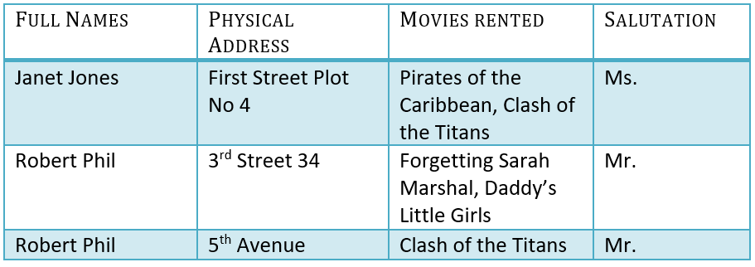
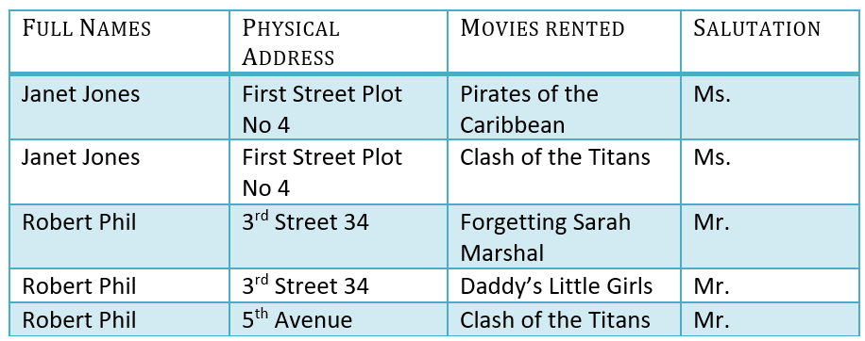
1NF (First Normal Form)
Normalization
Movies Rented column has multiple values
1NF (First Normal Form) Rules
Each table cell should contain a single value.
Each record needs to be unique.
1NF

Slide 58
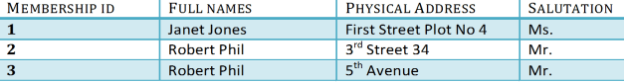
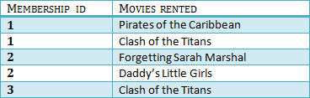
2NF (Second Normal Form)
Normalization
Rule 1- Be in 1NF
Rule 2- Single Column Primary Key that does not functionally dependent on any subset of candidate key relation
2NF

Slide 59
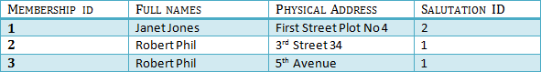
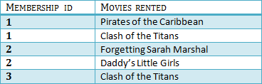
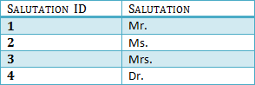
3NF (Third Normal Form)
Normalization
Rule 1- Be in 2NF
Rule 2- Has no transitive functional dependencies
3NF

Slide 60
Application Programing Interface (API)

Slide 61
What is API and API Testing?
API (Application Programming Interface) is a computing interface which enables communication and data exchange between two separate software systems.
API TESTING is a software testing type that validates Application Programming Interfaces (APIs). The purpose of API Testing is to check the functionality, reliability, performance, and security of the programming interfaces.

Slide 62
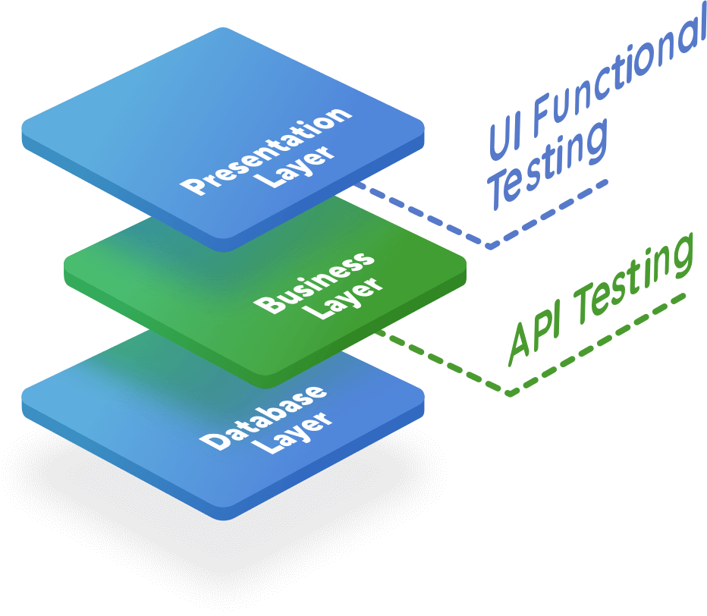
API Testing
In software application (app) development, API is the middle layer between the presentation (UI) and the database layer. APIs enable communication and data exchange from one software system to another.
API testing is performed at the most critical layer of software architecture, the Business Layer. It is in the business layer, business logic processing is carried out, and all transactions between User Interface(UI) and database happen.

Slide 63
Benefits of API Testing
Language-independent: Data is exchanged via XML and JSON formats, so any language can be used for test automation. XML and JSON are typically structured data, making the verification fast and stable. There are also built-in libraries to support comparing data using these data formats.
GUI-independent: API testing can be performed in the app prior to GUI testing. Early testing means early feedback and better team productivity. The app's core functionalities can be tested to expose small errors and to evaluate the build's strengths.
Improved test coverage: Most API/web services have specifications, allowing you to create automated tests with high coverage — including functional testing and non-functional testing.
Faster releases: It is common that executing API testing saves up to eight hours compared to UI testing, allowing software development teams to release products faster.

Slide 64
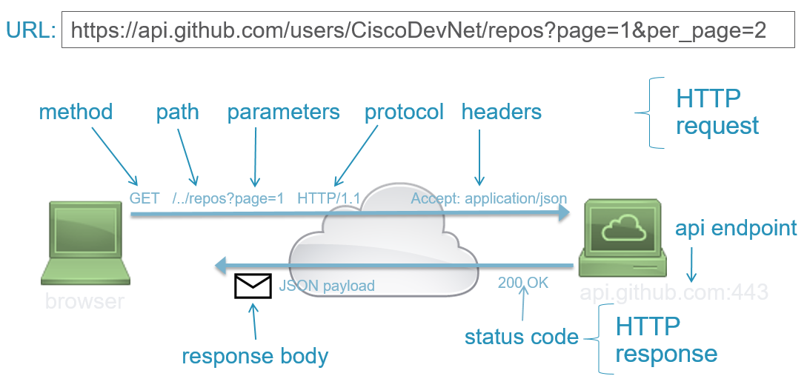
API Request Components
Any REST request includes four essential parts: an HTTP method, an endpoint, headers, and a body.
An HTTP method describes what is to be done with a resource. There are four basic methods also named CRUD operations:
POST to Create a resource,
GET to Retrieve a resource,
PUT to Update a resource, and
DELETE to Delete a resource.
Headers store information relevant to both the client and server. Mainly, headers provide authentication data — such as an API key, the name or IP address of the computer where the server is installed, and the information about the response format.
A body is used to convey additional information to the server. For instance, it may be a piece of data you want to add or replace.
An endpoint contains a Uniform Resource Identifier (URI) indicating where and how to find the resource on the Internet. The most common type of URI is a Unique Resource Location (URL), serving as a complete web address.

Slide 65
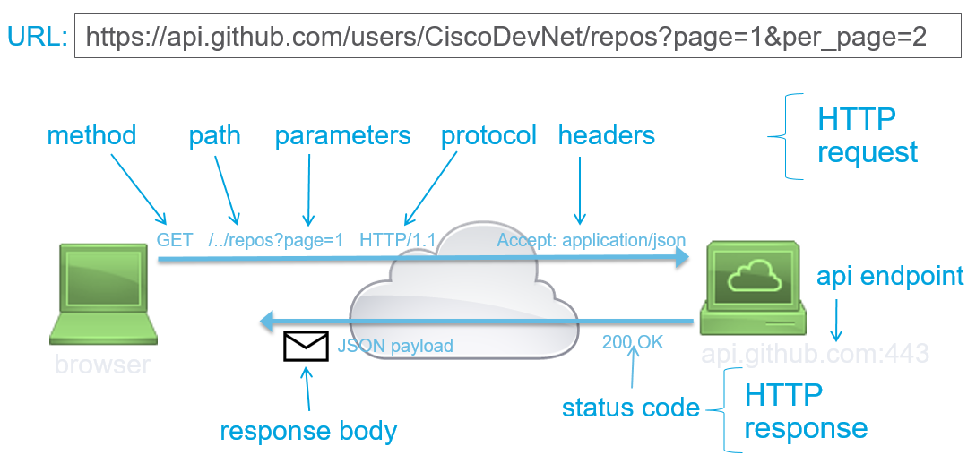
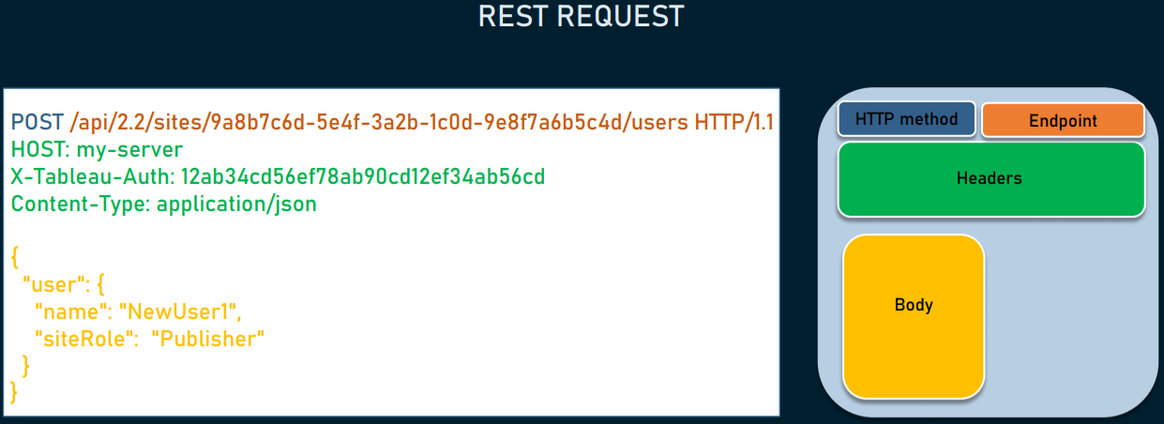
API Request Components

Slide 66
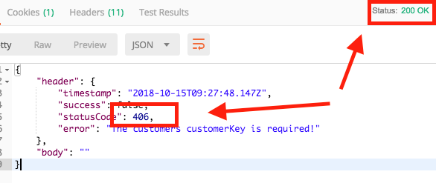
API Response Components
Any REST Response includes three essential parts: status code, Response Header, and Response Body
Status code informs the client if the action was performed correctly or not on the requested resource. It's a number with three digits (between 100 and 599) with a name, like 200 Success, or 404 Not Found. There are many status codes grouped into five main categories: informational responses (1xx), successes (2xx), redirections (3xx), client errors (4xx), and server errors (5xx).
The Response Header contains the information about the content that is being returned in response together with data about the Server that sent it.
The response body contains the requested information in the format specified by the Accept field in the request header. For JSON, the body is typically an object or an array of objects.
Notes:
Let's see some API call scenarios with the corresponding ideal status code:
• GET /users:
o users were successfully retrieved: 200 OK
o consumer is not authenticated: 401 Unauthorized
o server is down: 503 Service Unavailable
• GET /users/1234:
o users with id 1234 was not found: 404 Not Found
• POST /users:
o new user was successfuly created: 201 Created

Slide 67
HTTP Methods and status codes for REST API
Method | Description
GET | Retrieves the information at a particular URL.
PUT | Updates the previous resource if it exists or creates new information at a particular URL.
POST | Used to send information to the server like uploading data and to develop a new entity.
DELETE | Deletes all current representations at a specific URL.
PATCH | This is used for partial updates of resources.
No | Status Code | Description
1 | 1xx (100 – 199) | The response is informational.
2 | 2xx (200 – 299) | Assures successful response.
3 | 3xx (300 – 399) | You are required to take further action to fulfil the request.
4 | 4xx (400 – 499) | There’s a bad syntax and the request cannot be completed.
5 | 5xx (500 – 599) | The server entirely fails to complete the request.

Slide 68
API Testing Activity
Use this link for practicing API Testing
https://demoqa.com/swagger/#/

Slide 69
Defect Management Process
Defect Rejection Ratio
(No.of defects rejected/Total no.of defects raised)*100
Defect Leakage Ratio
(No.of defects missed/Total defects of software)*100
How to measure and evaluate the quality of the test execution?

Slide 70
Defect Management Process
Example:
Supposed the Bank website has total 64 defects, but your testing team only detect 44 defects i.e., they missed 20 defects. Therefore, you can calculate:
- The defect leakage ratio (DLR) is 20/64 = 0.312 (31.2 %).
Example:
Out of 84 defects, we reported over the 64 are defects which means our 20 defects we reports are all wrong, it is a mistake during testing period so how we can calculate defect rejection ratio?
- The defect rejection ratio (DRR) is 20/84 = 0.238 (23.8 %).

Slide 71
Test Planning

Slide 72
TEST PLAN
A Test Plan is a detailed document that describes the test strategy, objectives, schedule, estimation, deliverables, and resources required to perform testing for a software product.
Test Plan helps us determine the effort needed to validate the quality of the application under test.
The test plan serves as a blueprint to conduct software testing activities as a defined process, which is minutely monitored and controlled by the test manager.
ISTQB definition: “Test Plan is A document describing the scope, approach, resources, and schedule of intended test activities.”

Slide 73
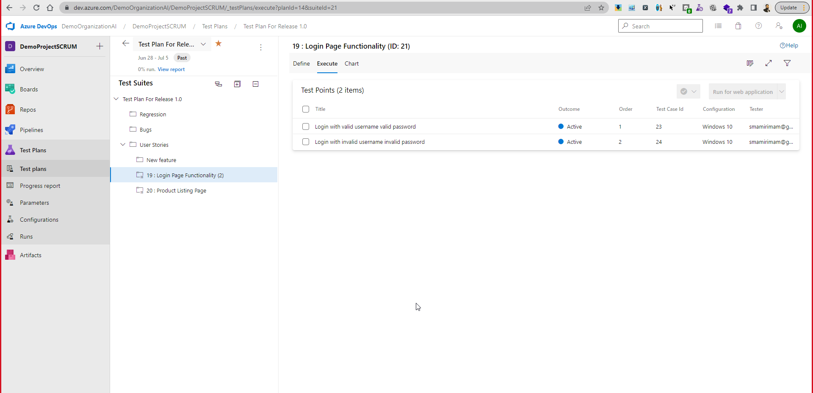

Slide 74
What is the Importance of Test Plan?
Making Test Plan document has multiple benefits
Help people outside the test team such as developers, business managers, customers understand the details of testing.
Test Plan guides our thinking. It is like a rule book, which needs to be followed.
Important aspects like test estimation, test scope, Test Strategy are documented in Test Plan, so it can be reviewed by Management Team and re-used for other projects.

Slide 75
Test Plan Attribute
Objective
Scope
Test Methodology
Approach
Assumption
Risk
Test Plan Attribute
Mitigation Plan
Roles & Responsibilities
Schedule
Defect Tracking
Test Environment
Entry & Exit Criteria
Test Automation
Effort Estimation
Deliverables
Templates

Slide 76
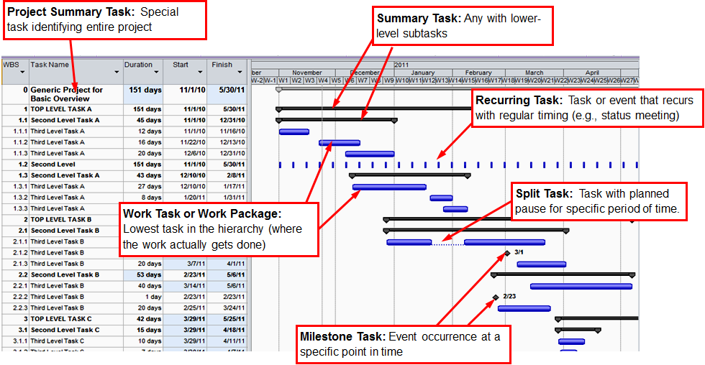
Gantt Chart

Slide 77
How to write a Test Plan
Analyze the product
Design the Test Strategy
Define the Test Objectives
Define Test Criteria
Resource Planning
Plan Test Environment
Schedule & Estimation
Determine Test Deliverables

Slide 78
Analyze the product
Design the Test Strategy
Define the Test Objectives
Define Test Criteria
Resource Planning
Plan Test Environment
Schedule & Estimation
Determine Test Deliverables
Analyze the product
Start with learning more about the product being tested, the client, and the end-users of similar products. Ideally, this phase should focus on answering the following questions:
Who will use the product?
What is the main purpose of this product?
How does the product work?
What are the software and hardware specifications?
In this stage, do the following:
Interview clients, designers, and developers
Review product and project documentation
Perform a product walkthrough

Slide 79
Analyze the product
Define the Test Objectives
Define Test Criteria
Resource Planning
Plan Test Environment
Schedule & Estimation
Determine Test Deliverables
Design the Test Strategy
Develop Test Strategy
Test Strategy is an outline that describes the testing approach of the software development cycle
A Test Strategy document, is a high-level document, which is usually developed by Test Manager.
This document defines:
The project’s testing objectives and the means to achieve them
Determines testing effort and costs

Slide 80
Analyze the product
Design the Test Strategy
Define the Test Objectives
Define Test Criteria
Resource Planning
Plan Test Environment
Schedule & Estimation
Determine Test Deliverables
Define the Test Objectives
This phase defines the goals and expected results of test execution. Since all testing intends to identify as many defects as possible, the objects must include:
A list of all software features – functionality, GUI, performance standards- that must be tested.
The ideal result or benchmark for every aspect of the software that needs testing. This is the benchmark to which all actual results will be compared.

Slide 81
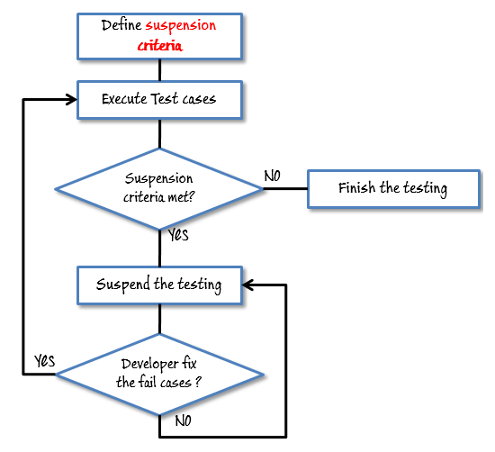
Analyze the product
Design the Test Strategy
Define the Test Objectives
Define Test Criteria
Resource Planning
Plan Test Environment
Schedule & Estimation
Determine Test Deliverables
Define Test Criteria
Test Criteria refers to standards or rules governing all activities in a testing project. The two main test criteria are:
Suspension Criteria: Defines the benchmarks for suspending all tests. For example, if QA team members find that 50% of all test cases have failed, then all testing is suspended until the developers resolve all the bugs that have been identified so far.
Exit Criteria: Defines the benchmarks that signify the successful completion of a test phase or project. The exit criteria are the expected results of tests and must be met before moving on to the next stage of development. For example, 80% of all test cases must be marked successful before a particular feature or portion of the software can be considered suitable for public use.

Slide 82
Analyze the product
Design the Test Strategy
Define the Test Objectives
Define Test Criteria
Resource Planning
Plan Test Environment
Schedule & Estimation
Determine Test Deliverables
Resource Planning
Resource plan is a detailed summary of all types of resources required to complete project task.
Resource could be human, equipment and materials needed to complete a project
The resource planning is important factor of the test planning because helps in determining the number of resources (employee, equipment…) to be used for the project. Therefore, the Test Manager can make the correct schedule & estimation for the project.
This section represents the recommended resources for your project.

Slide 83
Analyze the product
Design the Test Strategy
Define the Test Objectives
Define Test Criteria
Resource Planning
Plan Test Environment
Schedule & Estimation
Determine Test Deliverables
What is the Test Environment
A testing environment is a setup of software and hardware on which the testing team is going to execute test cases.
The test environment consists of real business and user environment, as well as physical environments, such as server, front end running environment.

Slide 84
Analyze the product
Design the Test Strategy
Define the Test Objectives
Define Test Criteria
Resource Planning
Plan Test Environment
Schedule & Estimation
Determine Test Deliverables
Schedule And Estimation
Then, create a schedule to complete these tasks in the designated time with the specific amount of effort. Creating the schedule, however, does require input from multiple perspectives:
Employee and project deadline: The working days, the project deadline, resource availability are the factors which affected to the schedule
Project Estimation: Based on the estimation, the Test Manager knows how long it takes to complete the project. So, he can make the appropriate project schedule
Project Risk: Understanding the risk helps Test Manager add enough extra time to the project schedule to deal with the risks

Slide 85
Analyze the product
Design the Test Strategy
Define the Test Objectives
Define Test Criteria
Resource Planning
Plan Test Environment
Schedule & Estimation
Determine Test Deliverables
Test Deliverables is a list of all the documents, tools and other components that has to be developed and maintained in support of the testing effort. There are different test deliverables at every phase of the software development lifecycle.
Before Testing
During Testing
After the testing
Test plans document.
Test cases documents
Test Design specifications.
Test Scripts
Simulators.
Test Data
Test Traceability Matrix
Error logs and execution logs.
Test Results/reports
Defect Report
Installation/ Test procedures guidelines
Release notes

Slide 86
Test Strategy
Scope of Testing
Contains the software components (hardware, software, middleware) to be tested and those that will not be tested.
Type of Testing
Describes the types of tests to be used in the project. This is necessary since each test identifies specific types of bugs.
Risks and Issues
Describes all possible risks that may occur during testing – tight deadlines, insufficient management, inadequate or erroneous budget estimate – as well as the effect of these risks on the product or business.
Test Logistics
Mentions the names of testers (or their skills) as well as the tests to be run by them. This section also includes the tools and the schedule laid out for testing.

Slide 87
Human Resource
No. | Member | Tasks
1. | Test Manager | Manage the whole project Define project directions Acquire appropriate resources
2. | Tester | Identifying and describing appropriate test techniques/tools/automation architecture Verify and assess the Test Approach Execute the tests, Log results, Report the defects. Tester could be in-sourced or out-sourced members, base on the project budget For the task which required low skill, I recommend you choose outsourced members to save project cost.
3. | Developer in Test/ Automation Engineer | Implement the test cases/Script, test program, test suite etc.
4. | Test Administrator | Builds up and ensures Test Environment and assets are managed and maintained Support Tester to use the test environment for test execution
5. | SQA members | Take in charge of quality assurance Check to confirm whether the testing process is meeting specified requirements

Slide 88
System Resource
No. | Resources | Descriptions
1. | Server | Install the web application under test This includes a separate web server, database server, and application server if applicable
2. | Test Tool | The testing tool is to automate the testing, simulate the user operation, generate the test results There are tons of test tools you can use for this project such as Selenium, QTP…etc.
3. | Network | You need a Network include LAN and Internet to simulate the real business and user environment
4. | Computer | The PC which users often use to connect the web server

Slide 89
Schedule And Estimation
For test estimation, break down the project into smaller tasks and allocate time and effort required for each.
Task | Members | Estimate effort
Create the test specification | Test Designer | 170 man-hour
Perform Test Execution | Tester, Test Administrator | 80 man-hour
Test Report | Tester | 10 man-hour
Test Delivery |  | 20 man-hour
Total |  | 280 man-hour

Slide 90
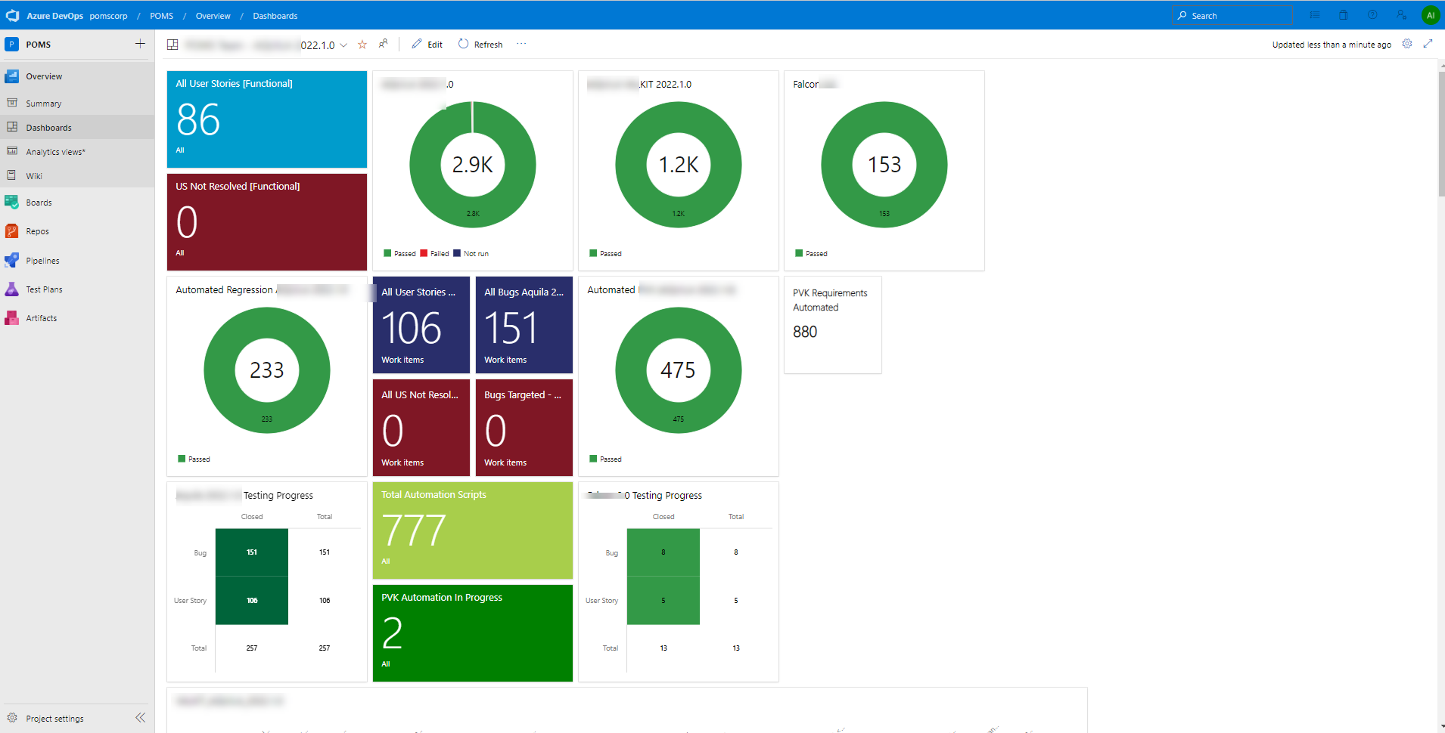
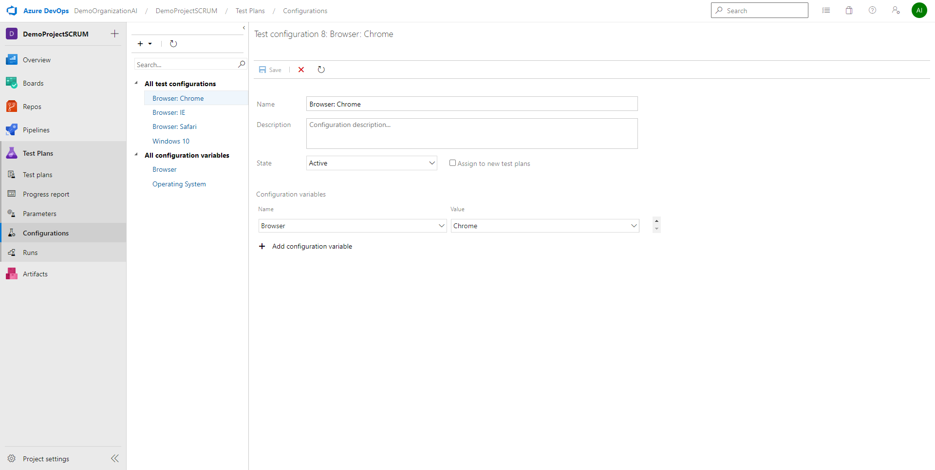
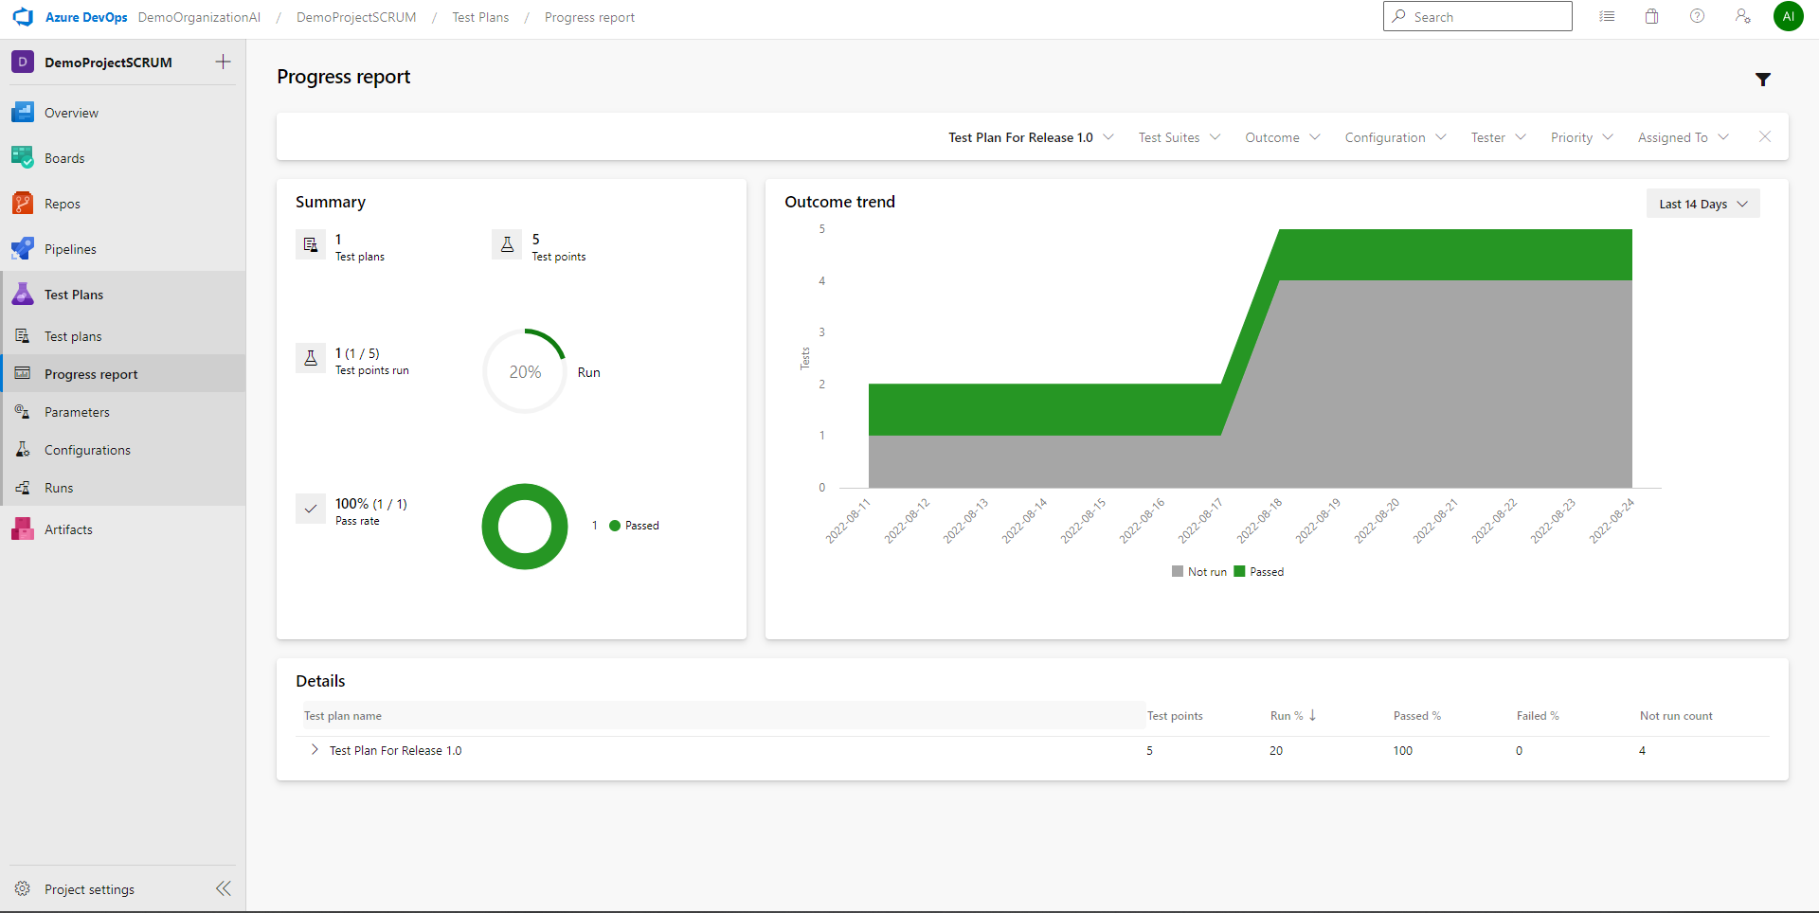
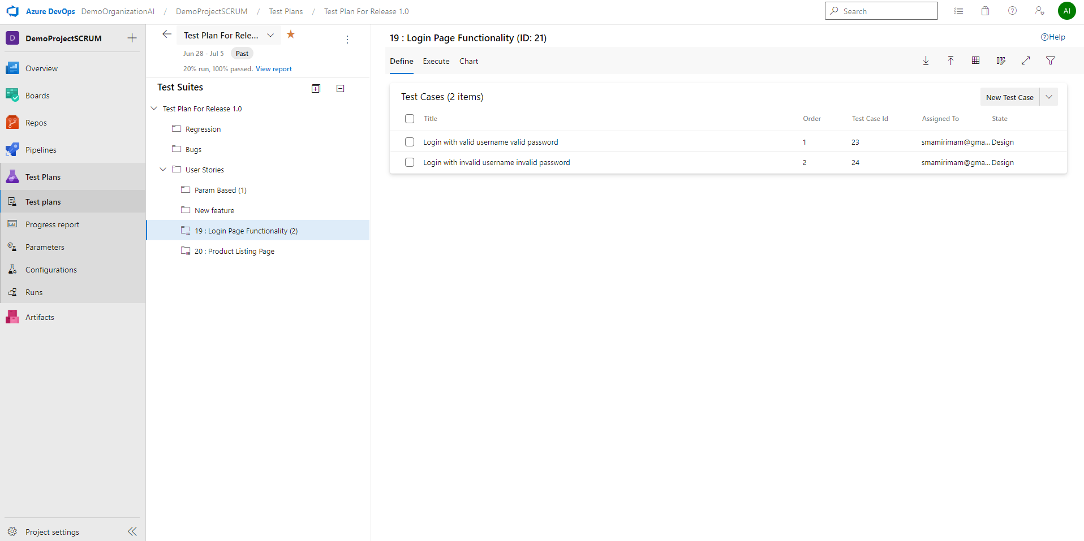
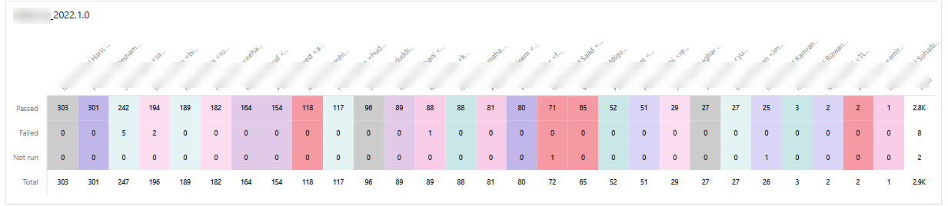

Slide 91
Cloud-Native Application
Cloud-Native Application Testing
Cloud native technologies empower organizations to build and run scalable applications in modern, dynamic environments such as public, private, and hybrid clouds
These techniques enable loosely coupled systems that are resilient, manageable, and observable
Available Cloud Computing Services
Infrastructure as a Service (IaaS)
Platform as a Service (PaaS)
Software as a Service (SaaS)

Slide 92
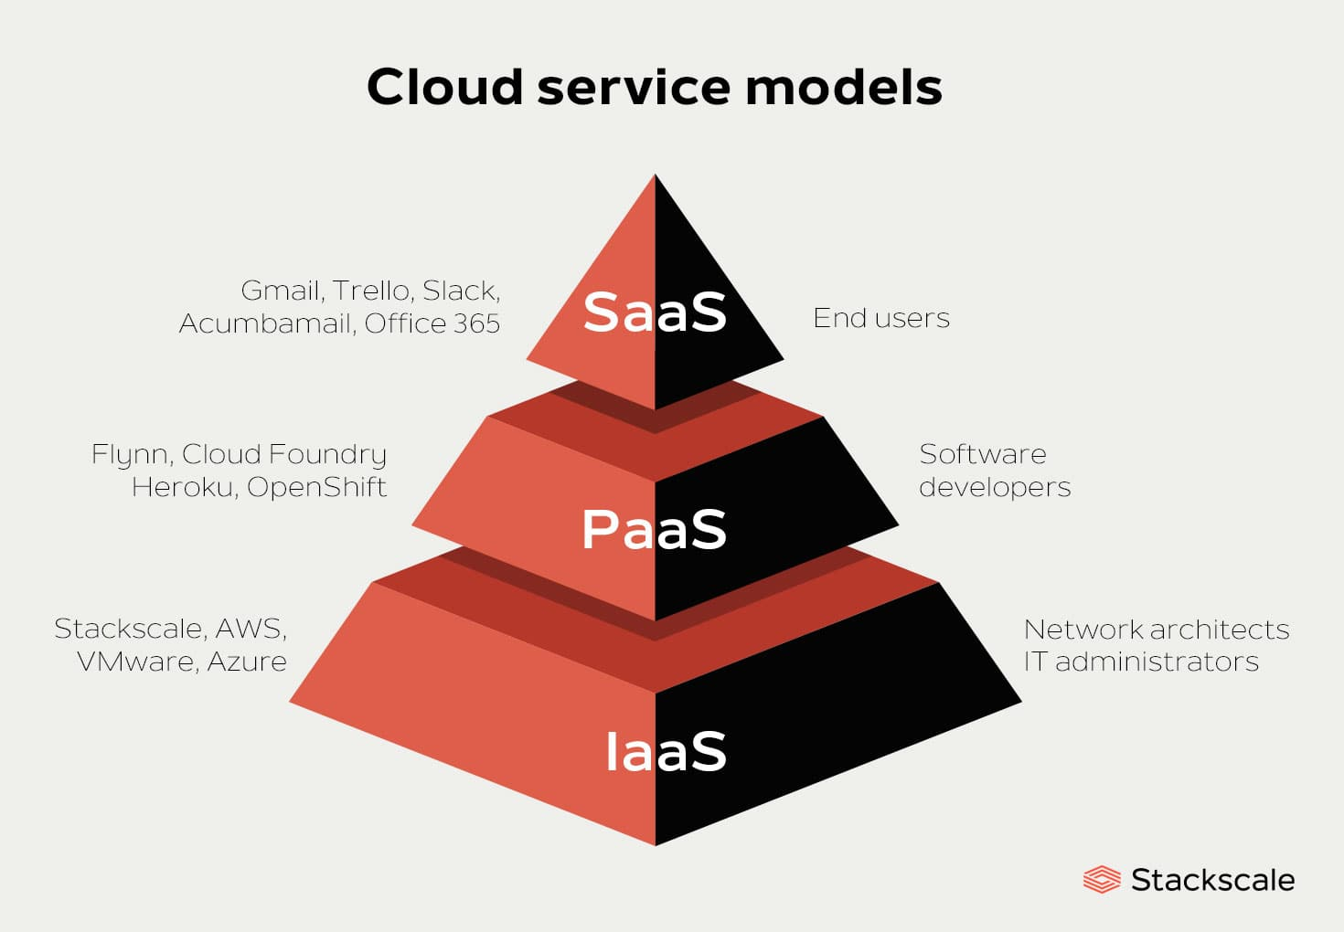
Cloud-Native Application
Cloud-Native Application Testing

Slide 93
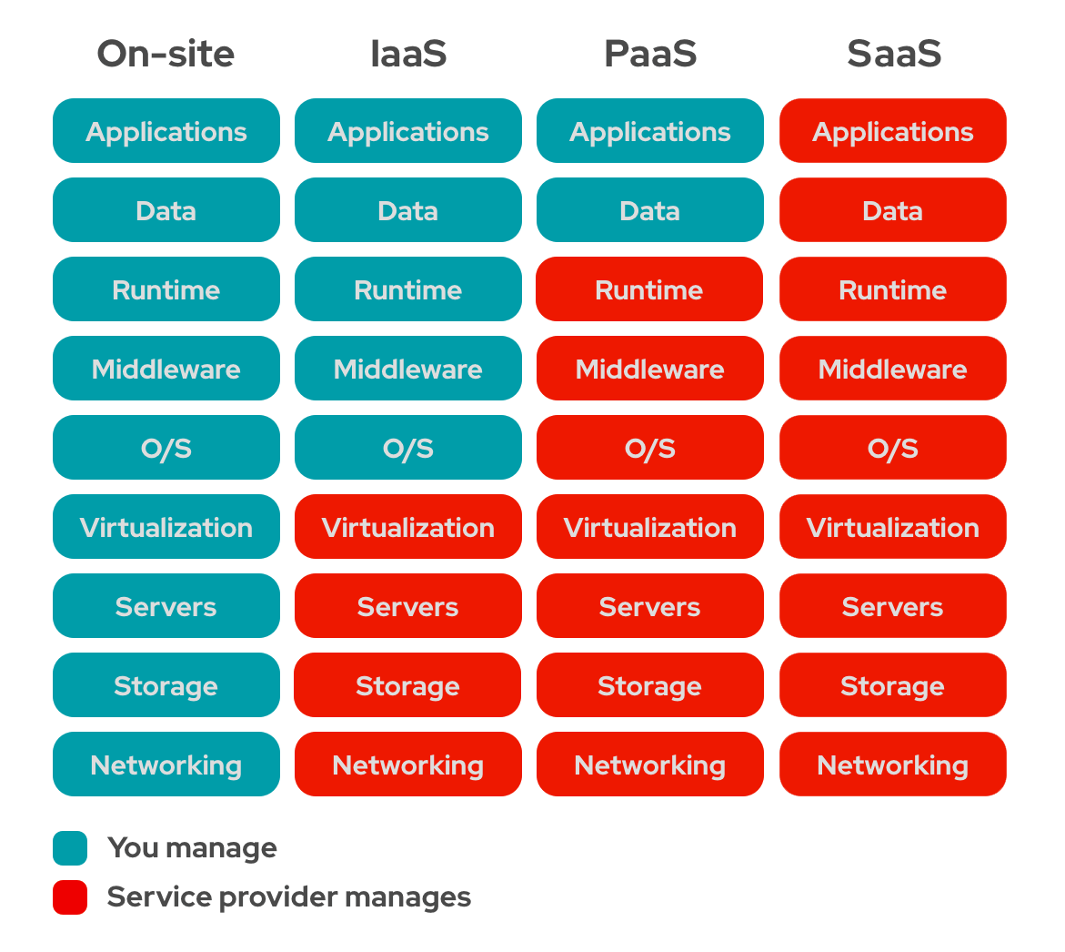
Shared Ownership
Cloud-Native Application Testing
As a Tester, you need to focus on testing with respect to the ownership of the company
i.e.
If you are user of these models then your testing scope will be the Blue blocks
If you are the cloud service provider then then your testing scope will be the Red blocks

Slide 94
Infrastructure as a Service (IaaS)
Cloud-Native Application Testing
Provides end users with cloud-based alternatives to on-premise physical infrastructure
Allowing businesses to purchase resources on-demand
Characteristics
Highly flexible and highly scalable.
Accessible by multiple users.
Cost-effective.
Examples
AWS EC2: Provides virtual Servers
GCP Cloud Compute: Provides virtual Servers
Testing includes testing the infrastructure configuration, networking, security policy, etc

Slide 95
Platform as a Service (PaaS)
Cloud-Native Application Testing
Cloud platform services that provides developers with a framework, software and tools needed to build apps and software — all accessible through the internet.
More management responsibilities shifted to 3rd party service providers
Characteristics
Accessible by multiple users.
Scalable — customers can choose from various tiers of computing resources to suit the size of their business.
Built on virtualization technology.
Easy to run without extensive system administration knowledge.
Examples
AWS Elastic Beanstalk: Provides Management services of your application without the extensive system administration
GCP App Engine: Similar to AWS Elastic Beanstalk
Testing includes only your application, data and platform configurations

Slide 96
Software as a Service (SaaS)
Cloud-Native Application Testing
Cloud application services, is the most commonly used service within the cloud market
SaaS platforms make software available to users over the internet, usually for a monthly subscription fee.
Typically ready-to-user and web browser based solutions
Characteristics
Available over the Internet.
Hosted on a remote server by a third-party provider.
Ideal for small businesses or startups who cannot develop their own software applications.
Scalable, with different tiers for small, medium and enterprise-level businesses.
Inclusive, offering security, compliance and maintenance as part of the cost.
Examples
Google Workspace, Trello, Notion
Testing includes only the application testing

Slide 97
Analytics and Observability

Slide 98
User Analytics
Analytics
User analytics is a method for analyzing the users of digital products such as apps or software
Be able to answer:
Who are your customers, their age group, their locations, their interests group
How are they using your application, what actions are the performing, how much time they are taking on a page
Conversion ratio (i.e. page visits to actual purchases)
Which devices they are using
Common Tools
Google Analytics
Snowplow
Hotjar
Datadog - RUM

Slide 99
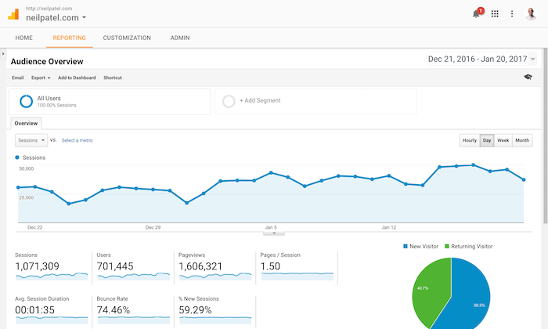
Analytics
User Analytics Using Google Analytics

Slide 100
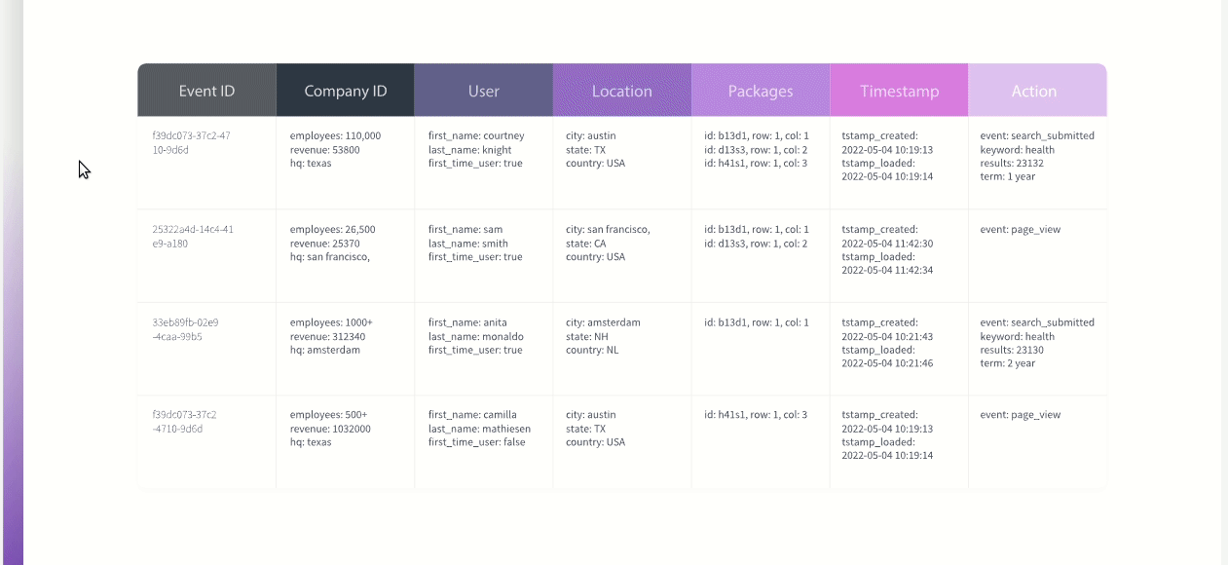
Analytics
Data Modeling using Snowplow

Slide 101
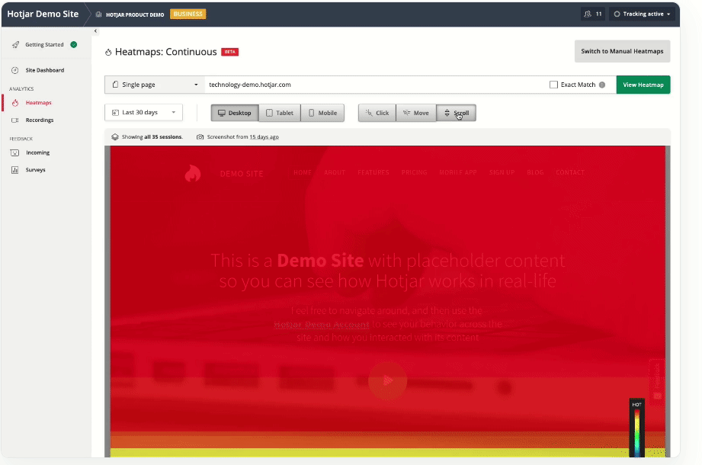
Analytics
Visual Analytics through recordings and heatmaps on Hotjar

Slide 102
Information is critical for testers to optimizing testing efforts and performing better risk-based testing
Analytics

Slide 103
Observability
Observability
Observability is a measure of how well internal states of a system can be inferred from knowledge of its external outputs
Observability allows teams to:
Monitor modern systems more effectively
Find and connect effects in a complex chain and trace them back to their cause
Enable visibility for system administrators, IT operations analysts, developers and testers into the entire architecture

Slide 104
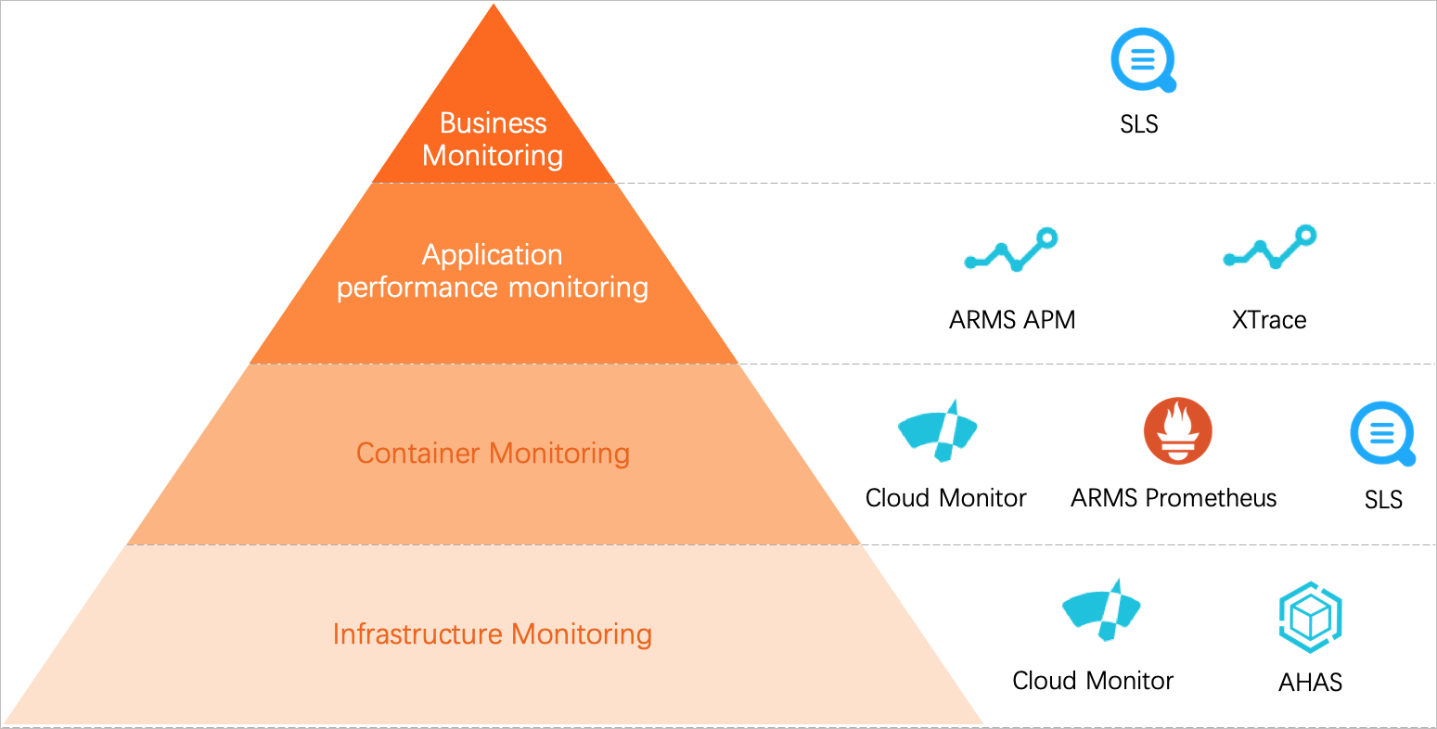
Observability
Observability
Primary Data sources for Observability
Logs
A log is a text record of an event that happened at a particular time and includes a timestamp that tells when it occurred and a payload that provides context
Metrics
a numeric value measured over an interval of time and includes specific attributes such as timestamp, name, KPIs and value
Traces
A trace represents the end-to-end journey of a request through a distributed system.

Slide 105
Observability
Observability
Key observability Matrices for all levels (Business, Application, Infrastructure)
Error Rate
Response time
Throughput
UpTime

Slide 106
Observability Data is important for Testers to identify hidden bugs during testing and to identify common causes of failures on production
Observability

Slide 107
What is Agile?
Agile is the ability to create and respond to change. It is a way of dealing with, and ultimately succeeding in, an uncertain and turbulent environment.

Slide 108
What is Agile?
Agile is a mindset informed by the Agile Manifesto’s values and principles. Those values and principles provide guidance on how to create and respond to change and how to deal with uncertainty.

Slide 109
What is Agile Software Development?
Agile Software Development is a term used to describe approaches to software development emphasizing incremental delivery, team collaboration, continual planning, and continual learning, instead of trying to deliver it all at once near the end.

Slide 110
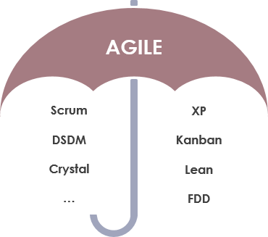
What is Agile Software Development?
Agile software development is more than frameworks such as Scrum, Extreme Programming, or Feature-Driven Development (FDD).
Agile software development is more than practices such as pair programming, test-driven development, stand-ups, planning sessions, and sprints.

Slide 111
Manifesto for Agile Software Development
4 Values
12 Principles
Manifesto

Slide 112
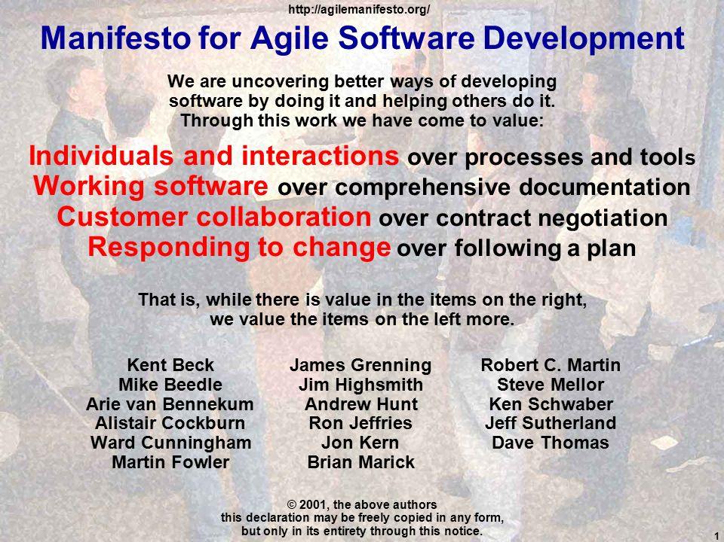
The Agile Manifesto

Slide 113
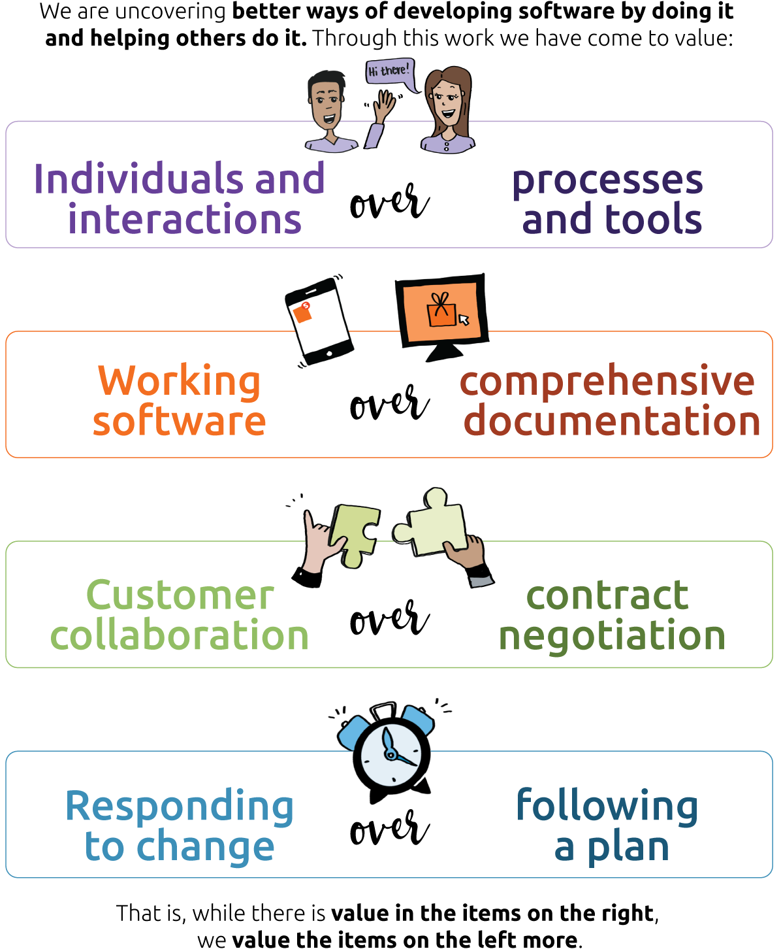
Agile Manifesto

Slide 114
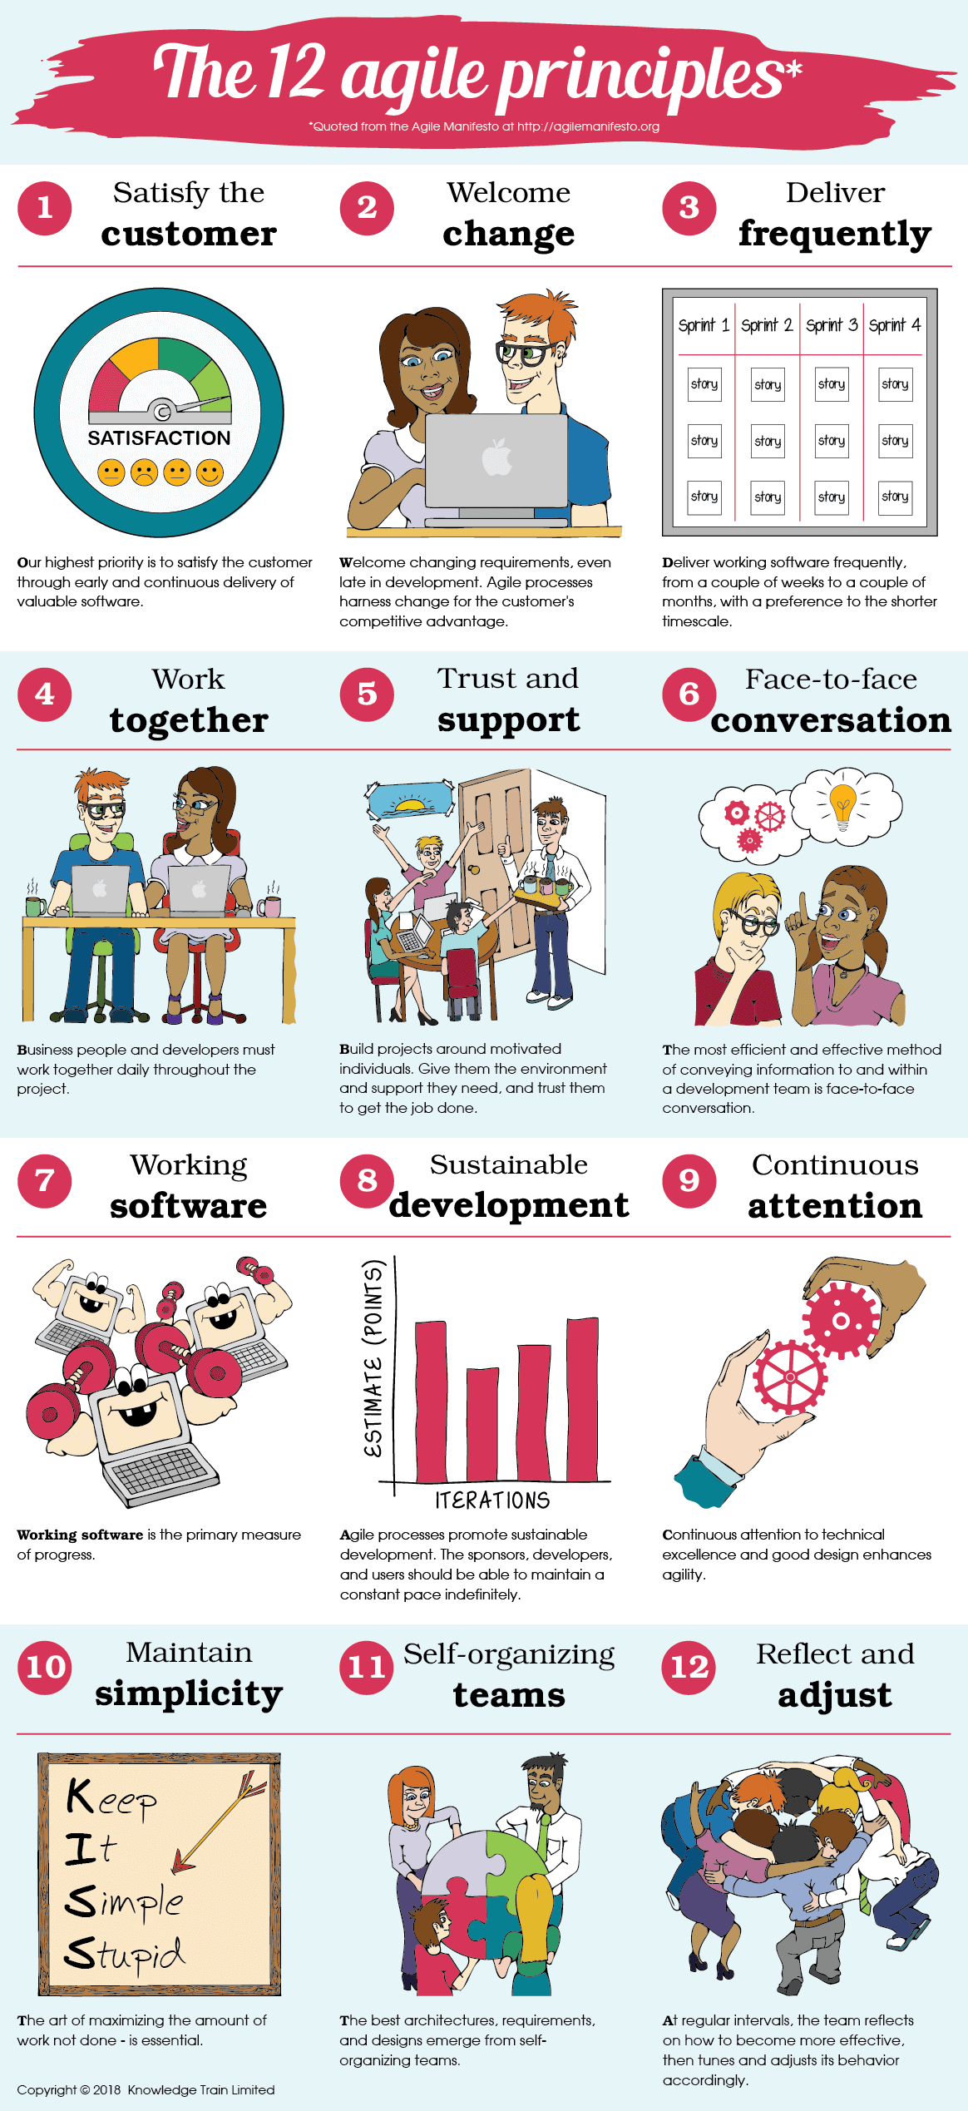
Agile Manifesto
12 Agile Principles

Slide 115
SCRUM

Slide 116
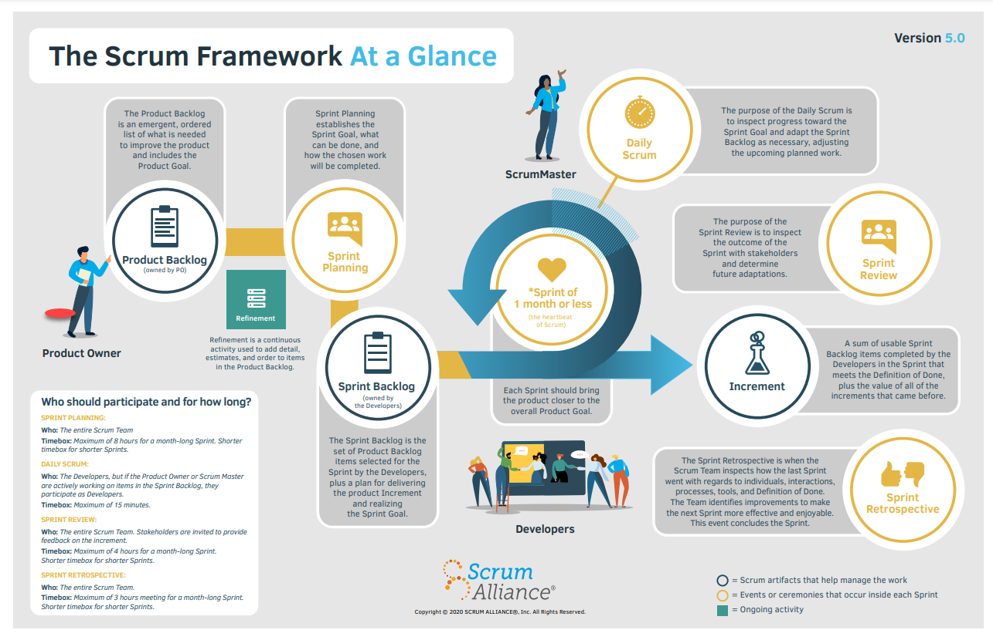

Slide 117
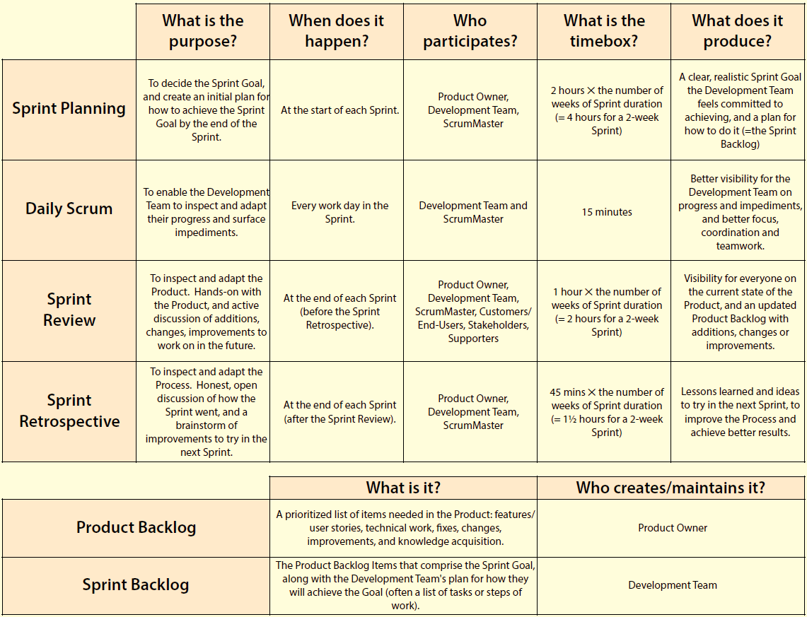

Slide 118
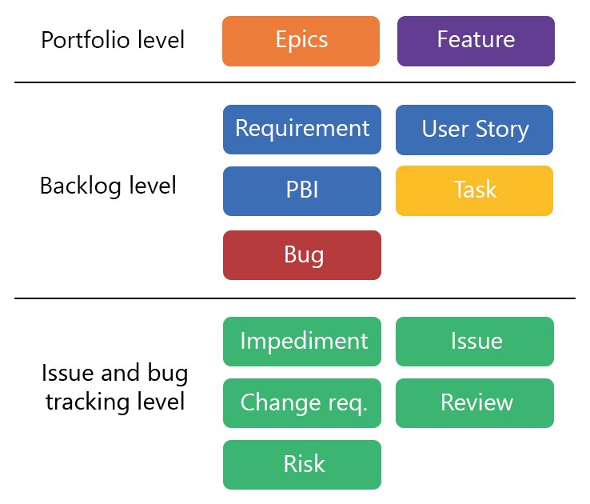
Work Items At Different Levels

Slide 119
SCRUM
SCRUM
03 Roles
05 Events
03 Artifacts
06 Principles
Product Owner
Scrum Master
Development Team
Sprint
Sprint Planning
Daily Scrum
Sprint Review
Sprint Retrospective
Product Backlog
Sprint Backlog
Product Increments
Empirical Process Control
Self-Organization
Collaboration
Value Based Prioritization
Time Boxing
Iterative Development

Slide 120

Agile Testing

Slide 121

SCRUM

Slide 122

Testing Dimensions

Slide 123


Slide 124

CI / CD

Slide 125


Slide 126

CI Pipeline

Slide 127
Kanban

Slide 128

Kanban

Slide 129

Kanban Azure DevOps

Slide 130

Kanban Principles

Slide 131
Kanban Principles

Slide 132
Kanban Principles

Slide 133
Kanban Principles

